Slide 1
Readiness ... is our Guiding Principle
Notes:
But there is a question here. Does everyone know who Mr. Williams was? How would he be valued in our organization? Don’t answer that.
In the next few minutes I will share with you some information about DEOMI D&I lessons (past/present/future).
Now, let me be clear, I am not teaching a course. Rather I will outline the courses, point out primary focus, list skills sets for DoD D&I experts, and the future.
The follow few slides will provide examples of elements of our courses.

Slide 2
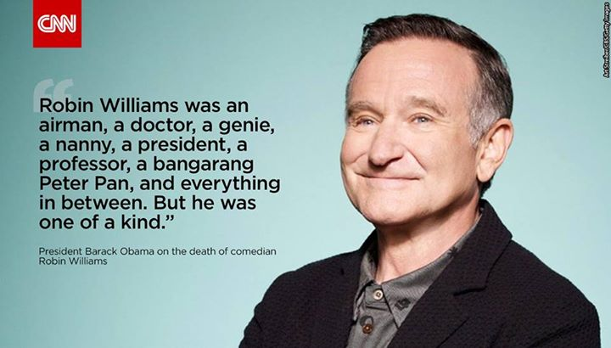
Robin Williams
Notes:
That is Robin Williams I am not.
You should not expect a lot of jokes from me.
I am more like Jack Webb, notihng

Slide 3
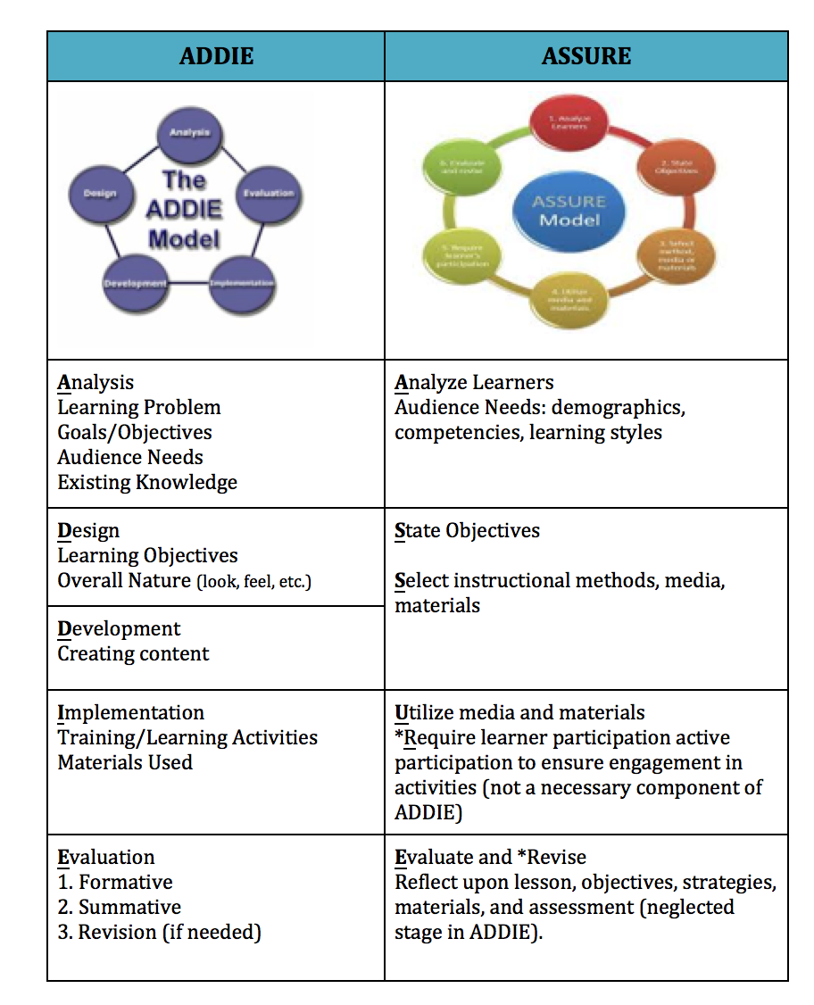
Notes:
We also have numerous definitions from numerous sources.

Slide 4
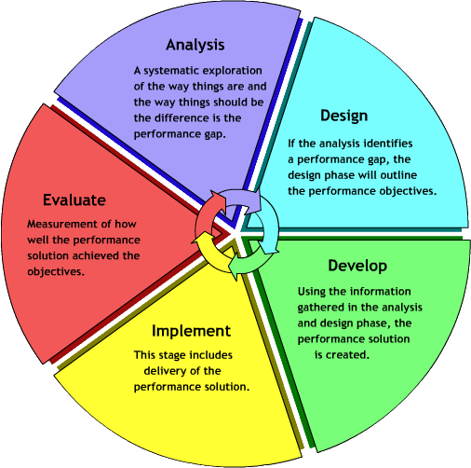
Notes:
We also have numerous definitions from numerous sources.

Slide 5
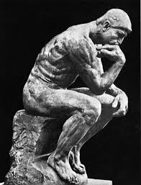
Objective
Explain the concept of diversity and illustrate how it can be used to help institutions capitalize on the unique talents of all its members
Notes:
One thing hou shuld see in this “Objective,” is we have limited ourselves to the “Diversity” concept.

Slide 6
Overview
How diversity was created
The business case for diversity
Knowledge vs. Truth
Define the concept of diversity
How to make it work
Notes:
Again the focus is on “Diversity.” some call this the AA approach or counting heads.
ADDIE
Course periodic Reviews

Slide 7
A Diverse Nation
All persons born or naturalized in the United States and subject to the jurisdiction thereof, are citizens of the United States and of the State wherein they reside. No State shall make or enforce any law which shall abridge the privileges or immunities of citizens of the United States; nor shall any State deprive any person of life, liberty, or property, without due process of law; nor deny to any person within its jurisdiction the equal protection of the laws.
14th Amendment to the U.S. Constitution 1868
Notes:
And it starts with a commitment. Our stance here is there are numerous sources that support a drive for diversity.
We start with the 14th, we could go back in history to support human rights. But we start here.

Slide 8
Creation of an Advanced Society
The industrial age was stimulated by WWI and WWII
It required a massive workforce
Immigrants, former slaves, and women played a key role
8
Notes:
A national motivation
A common thread here is work.

Slide 9
What influences our ability
to lead the innovative, creative,
and responsive organizations
of the 21st Century?

Slide 10
Anticipation
Technology
Readiness
Challenges
Managing Diversity
Business Case
Leading Diversity
Concerns
Integrity
Scripts
EO/EEO/AA
Leadership
Creativity
Opportunity
Change
Concepts Explored
Ethnocentrism
Systems
Learning Organizations
WOW!
Conflict
Valuing Diversity
Inclusion
Innovation
Paradigm Shift
Mission Success
Culture
Notes:
Various concepts covered in these courses. There are certainly more concepts.

Slide 11
Diversity Management Policy
Executive Order 13518, November 2009
Executive Order 13171, October 2000
Executive Order 13078, March 1998
Notes:
Policies that support movement.

Slide 12
Definitions
We define workforce diversity as a collection of individual attributes that together help agencies pursue organizational objectives efficiently and effectively.
We define inclusion as a set of behaviors (culture) that encourages employees to feel valued for their unique qualities and experience a sense of belonging.
We define inclusive diversity as a set of behaviors that promote collaboration amongst a diverse group.
- OPM 2016
As the challenges we face require a Joint Force that is flexible, agile, and adaptive, it emphasized people as much as platforms. It recognizes that the unique character of our Service members…is a formidable advantage. - 2011 National Military Strategy
Diversity is all the different characteristics and attributes of individuals that are
consistent with Department of Defense core values, integral to overall readiness
and mission accomplishment, and reflective of the Nation we serve. - MLDC 2011
The different characteristics and attributes of individuals. - DoD Directive 1020.02E
Diversity is all the different characteristics and attributes of the DoD’s Total Force, which are consistent with our core values, integral to overall readiness and mission accomplishment, and reflective of the nation we serve. - 2012-2017DoD D&I Strategic Plan
Notes:
We also have numerous definitions from numerous sources.

Slide 13
Air Force
Army
Marines
Navy
USCG
Definitions
Notes:
I’m not going to show all of these definitions but each Services has one. That information is shared and discussed in the classes.

Slide 14
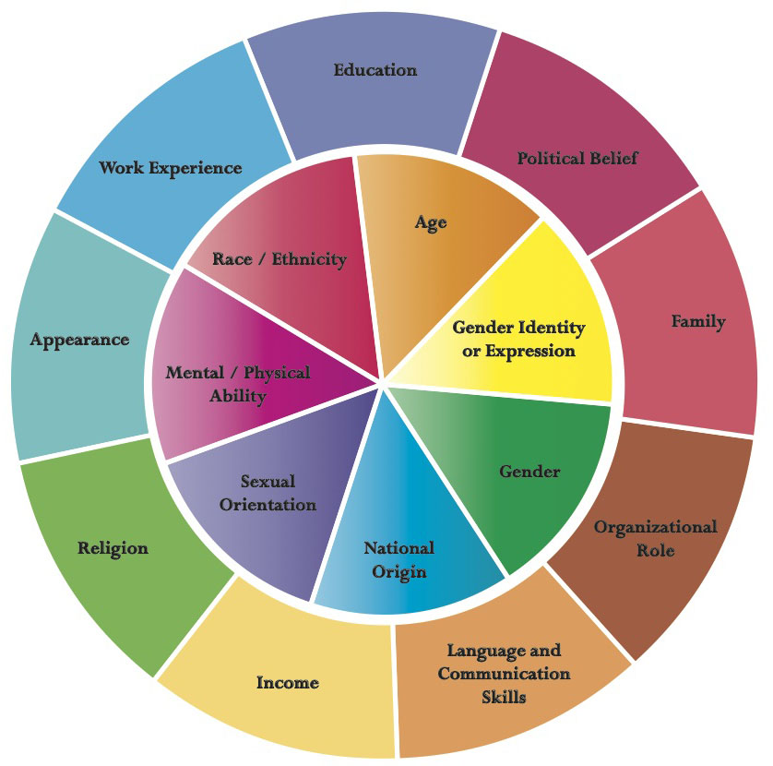
Loden Diversity Wheel 1991
Notes:
Definitions lead to the Loden Diversity Wheel. Over time this wheel has been the starting point for answering the question, “What does diversity look like?”

Slide 15
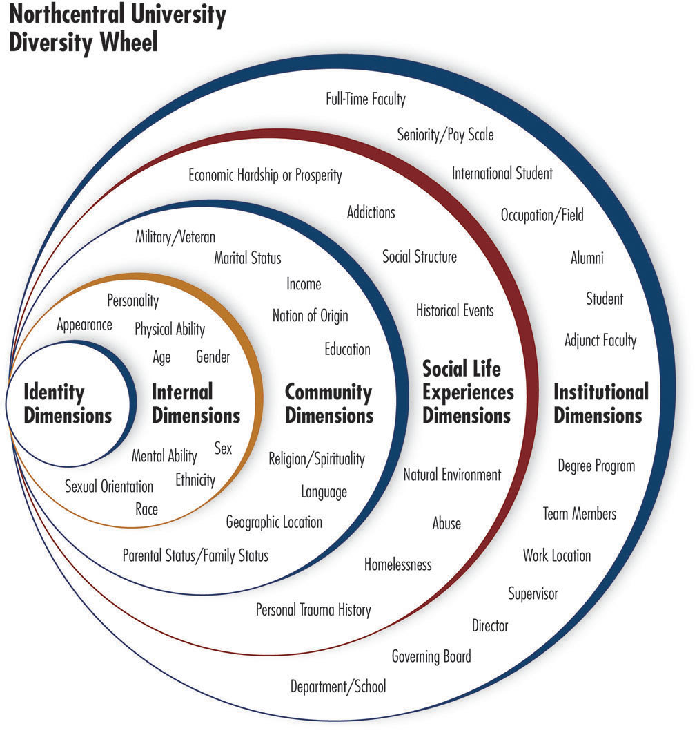
Northcentral University
Diversity Wheel
Notes:
Here is ow the Northcentral University has expressed it recently. There are others were these circles move form the individual to the organization. Same effect.

Slide 16
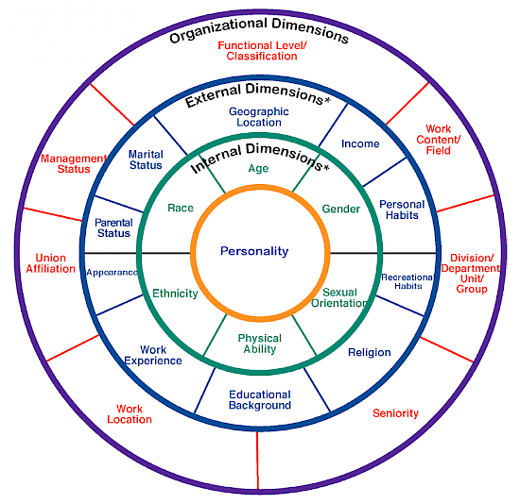
Loden & Rosener Diversity Wheel 1996
Notes:
Definitions lead to the Loden Diversity Wheel. Over time this wheel has been the starting point for answering the question, “What does diversity look like?”

Slide 17
SCRIPTS
Notes:
Some call it “What we have in our bag,” “what grandma told us, taps we replay for specific situations, or SCRIPS.
As I said before, we use over 160 hours in 3 of our major courses to discuss D&I concepts with the greater focus on the “DEOAC/EOARCC/LTAS.
Here are some common discuss points:

Slide 18
Environmental Characteristics
V
VOLATILE
U
UNCERTAIN
C
COMPLEX
A
AMBIGUOUS
Notes:
There are a number of factors to concern as we seek to be better diversity managers. I like to start with the world or environmental realities or VUCA. In addition we not only want to think of diversity and increasing or count heads but also how to make heads count in our mission.
We move from the individual to the team and organization. I call it VUCA, Tom Friedman calls it environmental forces, and others call it continuous white water. The content turbulence of the times. The world we live in and in which we must accomplish our mission.

Slide 19
Quiz
4 and 9
8, 11, 5, 14, 1, 7, 6, 16
Place the 4 and the 9
in the correct order
in this line of numbers.

Slide 20
The Path from Exclusive Club to Inclusive Organization
Tolerance of
Differences
Value the dominance of
one culture, style, group
Value added of diverse
cultures, styles, group
STATUS QUO
CHANGE
TRANSITION
Exclusive Passive Symbolic Critical Welcoming Inclusive
Club Club Difference Mass Organization
(“Pioneers”)
Notes:
Miller and Katz illustrate how businesses have addressed change and the motivation for the change. Consider where your organization is relative to these points on this continuum?
Exclusive
Passive
Symbolic
Critical Mass
Welcoming
Inclusive

Slide 21
Top Diversity Management Practices
Top Leadership Commitment
Strategic Plan
Diversity Linked to Performance
Measurement
Accountability
Succession Planning
Recruitment
Employment Involvement
Diversity Training
(GAO Report 2005, p. 4)

Slide 22
The Times, they area changing
The Real Challenges
Driving Forces
Globalism
Climate Control
Technology
How To Solve Them
People
Processes
Disciplines
Organizations
Technologies
Radically Inclusive
Thomas Friedman, 2016

Slide 23
The Majority of Diversity’s Attributes are
Unseen and Under Utilized
23
Notes:
Major Gary Richardson and Capt. Forbes, and Mr. Steinke use the Apple phone as a metaphor for how to take advantage of the diversity around us. How to use Apps?
This starts our discussion of possible management approaches.

Slide 24
Leading Diversity Strategies
Mastering inclusion is an art not a science
Multicultural competencies
Visible leadership commitment
Articulated definition of diversity
Leaders must ID areas where behaviors fall short of organizational values
Recognize challenges/celebrate success
Conduct culture audit

Slide 25
Systems and Approaches
Achieving diversity is a process, not an endpoint.
Secretary of Defense Cohen suggested a systems approach
that weaves together:
Policy
Communications
Education & Training
Enforcement
Assessment

Slide 26
Sociotechnical System Model
Environmental
Suprasystem
Goals &Values
Subsystem
Technical
Subsystem
Managerial
Subsystem
Psychosocial
Subsystem
Structural
Subsystem
Fremont E. Kast and James E. Rosenzweig, 1979
Notes:
We can overlay the Sociotechnical System Model over the Path and start discussions critical to move along the Path and make change.

Slide 27
Diversity and Inclusion
System Model
D&I
Suprasystem
Business
Acumen
Technical
Subsystem
Strategic
Leadership
Equity
And Transparency
Change
Management
Fremont E. Kast and James E. Rosenzweig, 1979
Notes:
We can overlay the Sociotechnical System Model over the Path and start discussions critical to move along the Path and make change.

Slide 28
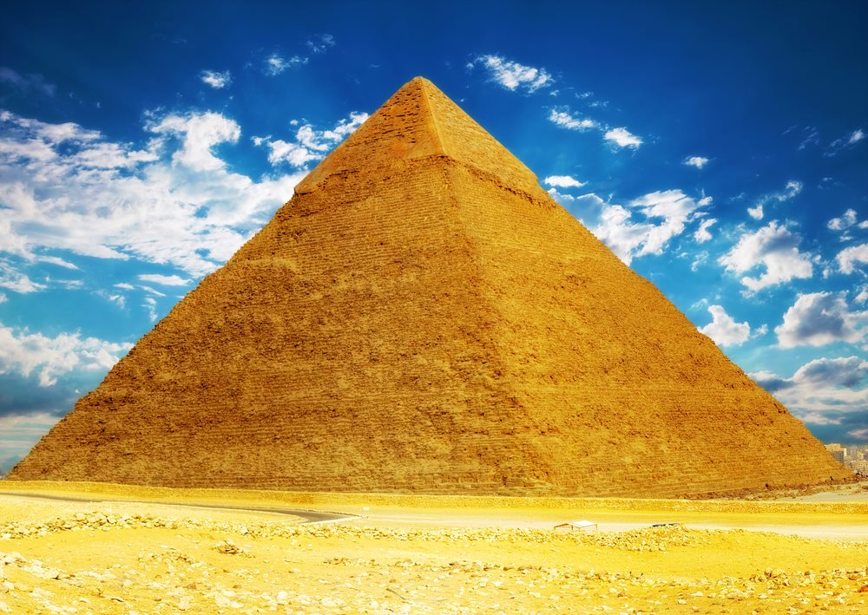
Preferred or Required Roles and Responsibilities
for Diversity Leaders
Strategic Leadership
Stakeholder Engagement
Tracking Diversity Trends
HR-Related Activities
Rand Corp. 2016

Slide 29
What elements are key to D&I?
Leadership skills
Business expertise
Interpersonal skills
EEO/MEO and AA
Personality and attitudes
Multicultural competence
Analytical abilities and skills
diversity knowledge and skills
Critical thinking and problem-solving skills
Knowledge, Skills, Abilities, and Other Personal characteristics
Rand Corp. 2016

Slide 30
Diversity Management Policy
Commitment to Change
Leadership Responsibility
Resources
Communication
(GAO, 2005)

Slide 31
Know your enemy and know yourself,
in a 100 battles you will never fail.
When you are ignorant of the enemy
but know yourself,
your chances of winning and losing
are equal.
If you are ignorant of both
the enemy and yourself,
you are certain in every battle to fail.
Notes:
I present to you a philosophy of life e and change. We must understand D&I , the environment, ROI, and what is the intent?

Slide 32
Assessment
Notes:
We also have numerous definitions from numerous sources.

Slide 33
Quiz
6,
8,
11,
5,
4,
14,
9,
1,
7,
16

Slide 34
Quiz
8, 11, 5, 4, 14, 9, 1, 7, 6, 16
Eleven
Eight
Five
Four
Fourteen
Nine
One
Seven
Six
Sixteen

